Slide 1

Console review

Slide 2
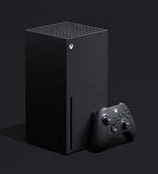
Microsoft Xbox Series X.
Xbox Series X restock sold out at Microsoft — where to find inventory next. Update: Microsoft is now sold out of consoles. Make sure to follow our Xbox Series X restock guide for hints on the next console drop. Also, check out our Black Friday Xbox Series X deals coverage for the best early deals on games and more.

Slide 3
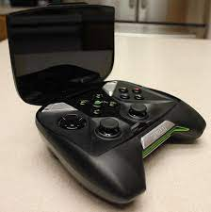
Nvidia Shield Portable
The Nvidia Shield Portable (Nvidia Shield or NSP) is a handheld game console developed by Nvidia,

Slide 4
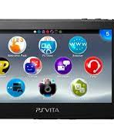
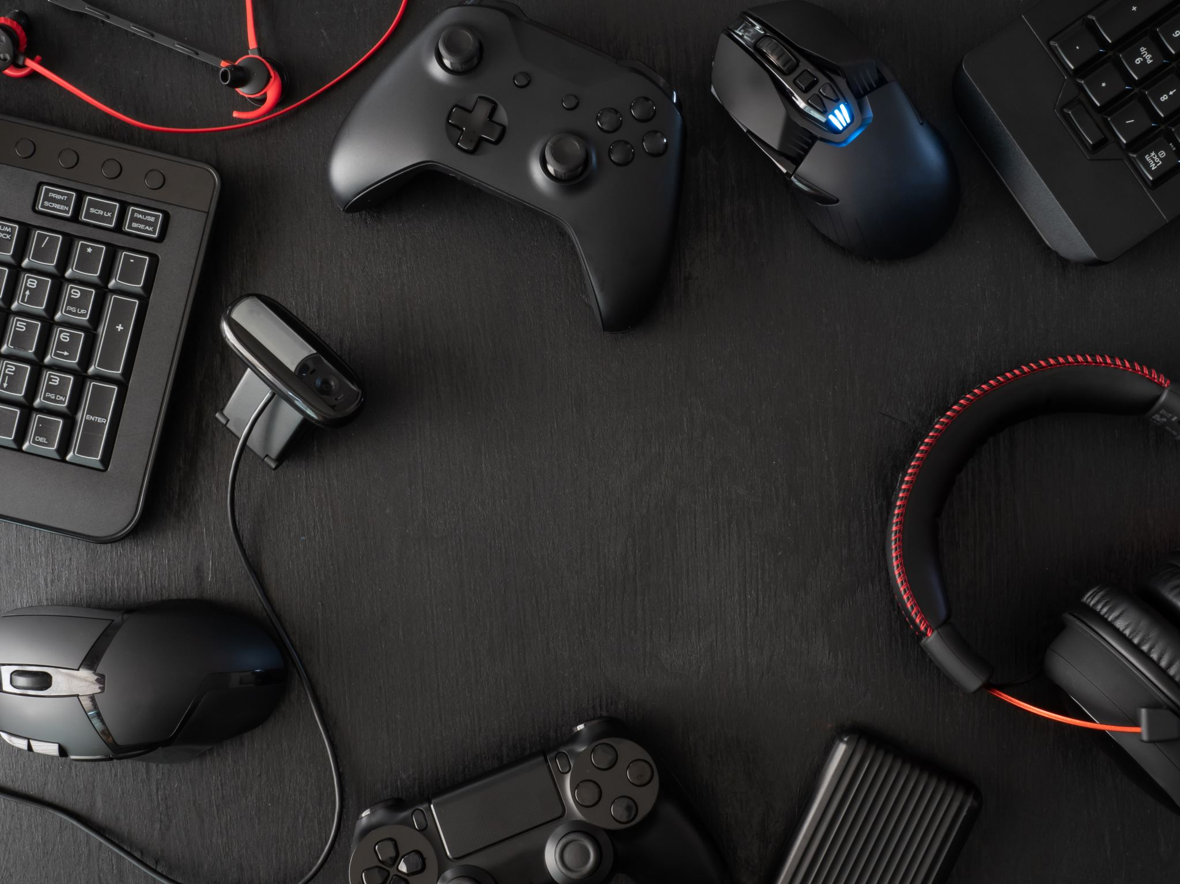
Sony PlayStation Vita Slim.
On September 20, 2018, Sony announced at Tokyo Game Show 2018 that the Vita would be discontinued in 2019, ending its hardware production. Production of new physical Vita games in Europe and America ceased by the end of Sony's 2018 fiscal year, which ended on March 31, 2019.

Slide 5
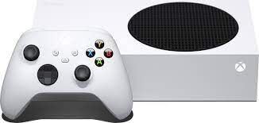
Microsoft Xbox Series S.
Introducing the Xbox Series S, the smallest, sleekest Xbox ever. Experience the speed and performance of a next-gen all-digital console at an accessible .

